Slide 1
MNT-EC Dissemination: Journal and Podcast
Peter Kazarinoff Portland Community College
Wed Oct 14, 2020 9am-10am PST

Slide 2
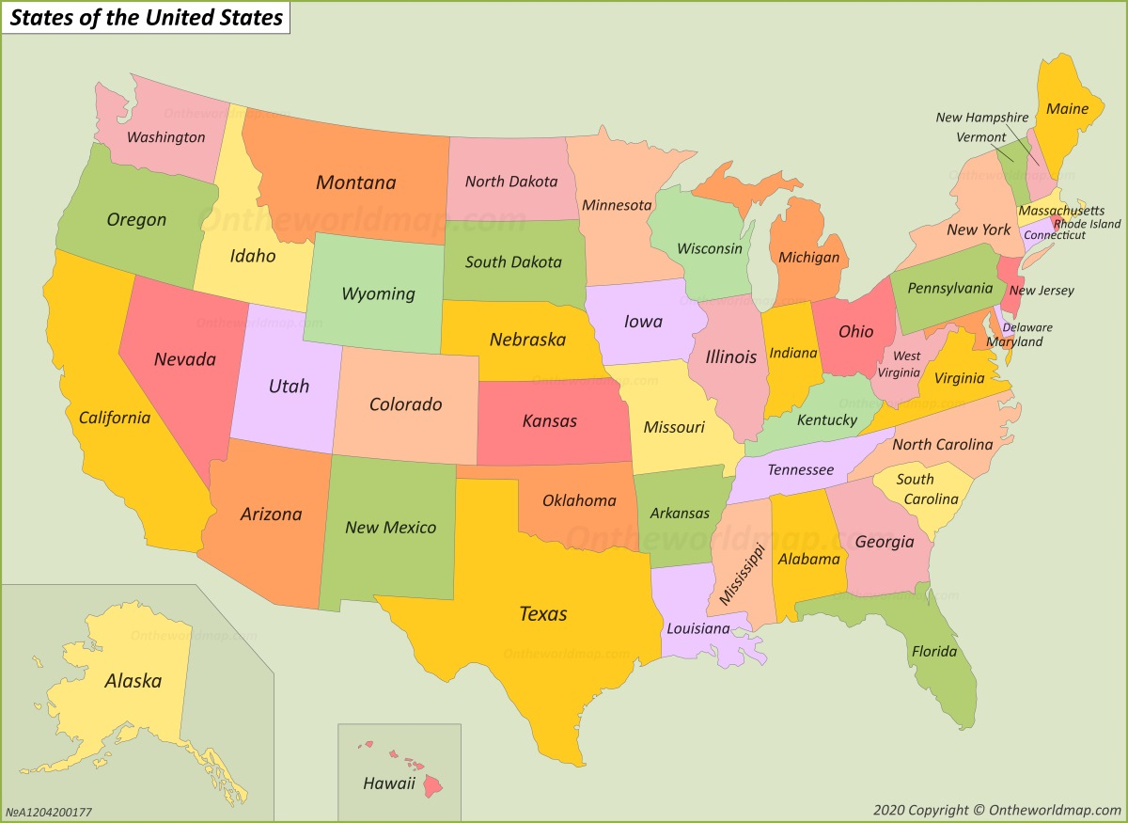
Who am I? Where are you?

Slide 3
Thee Take Aways:
1. The MNT-EC has a journal
2. The MNT-EC has a podcast
3. You can contribute

Slide 4
Take Away 1: Journal of Micro Nano Technician Education

Slide 5
Something to think about:
Have you read a scientific or professional journal since college or graduate school?
Have your written a scientific or pressional journal article since college or graduate school?
Why or Why Not?

Slide 6
Why publish?
Share you work with others
Collaborate with a colleague
Professional advancement
Grant proposals

Slide 7
Journal Article: Submission, Review, Publication

Slide 8
Poll Question: Do you have access to peer-reviewed journals at your institution

Slide 9
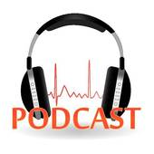
Take Away 2: Talking Technicians Podcast

Slide 10
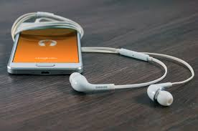
What is a podcast?
Why a podcast?

Slide 11
Talking Techinicans is a Podcast about Techncians
Each episode is an interview with a technician
Who are technicians?
Where do technicians come from?
What do technicians do?

Slide 12
How a podcast is made

Slide 13
Excerpt from Episode 1

Slide 14
Listen to the full episode Oct 31

Slide 15
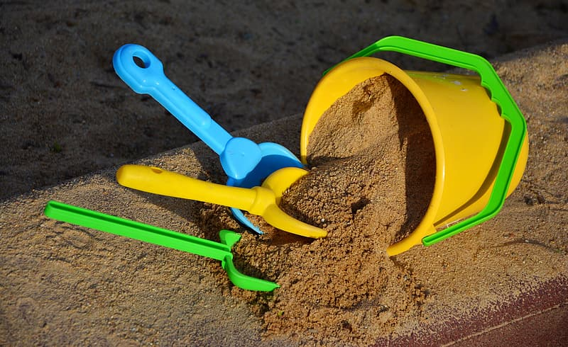
Take Away 3: You can contribute

Slide 16
MNT-EC Resources
Assistance with Grant submission
Professional Development for instructors
Conference abstract submissions, attendance
Assistance with Journal Paper Construction
Connections…

Slide 17
Collaboration Opportunities
Submit a Journal Article
Review a Journal Article
Review a Journal Article
Connect us with a podcast guest
Listen and share

Slide 18
Our first podcast guest
Cierstynn – Technican at Lawrence Livermore National Lab

Slide 19
Discussion: A student with a story?
peter.kazarinoff@pcc.edu

